Slide 1

F1: What’s New for Grade 8 Assessments?
Before Testing
During Testing
After Testing

Slide 2
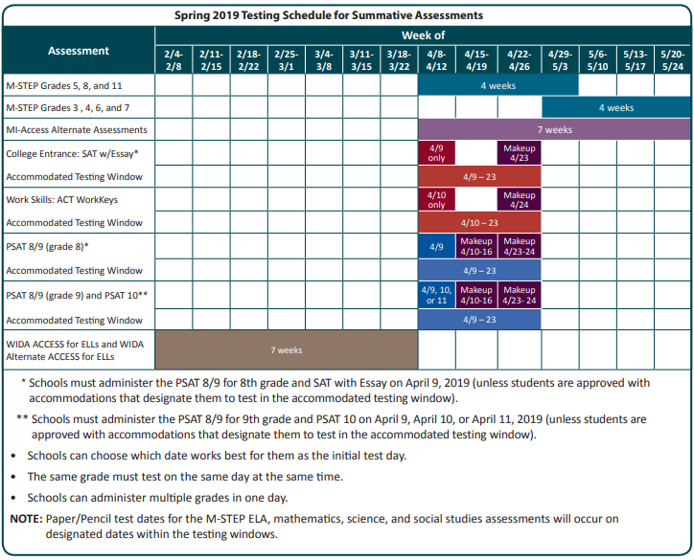
Testing Windows
Notes:
Here you see the 2019 spring testing window. This slide and the slides on the next couple of pages come directly from the Guide To State Assessments.
This document provides a good overview of the assessments being administered this spring and can be viewed or downloaded from any of the assessment webpages.
Students in grades 5, 8, and 11 are administered the online M-STEP assessments over 4 weeks from April 8 through May 3
Kids in grades 3, 4, 6, 7 take the M-STEP over 4 weeks from April 29 through May 24
Please note the week of April 29 is an overlap week and students in any grade may take an online M-STEP test
Students taking the paper/pencil form of M-STEP have 3 weeks. Those dates will be discussed later in the presentation
Students in grade 8 must take the PSAT 8/9 on April 9th. Eighth graders who are absent on April 9 may take the PSAT 8/9 in a makeup session either between April 10 through 16 or on April 23 or 24.
Students taking MI-Access may be administered the test over 7 weeks starting on April 8 and ending no later than May 24
Even though it is not on this chart because it is not a summative test, kindergarteners, and 1st and 2nd graders have the same 7 week window as MI-Access
Students in high school are assessed on designated days:
SAT with essay is administered to 11th graders on Tuesday April 9 with a makeup test day on April 23
11th graders also take the ACT WorkKeys assessment. The initial day of testing is Wednesday 4/10 with makeup testing taking place on April 24
9th graders take the PSAT 8/9 and 10th graders take the PSAT 10. Schools may choose either April 9, 10 or 11 for as an initial test date. Students can be administered the PSAT on separate days but all 9th graders must take the test on the same day and the same for 10th graders. There are two make-up windows: April 10-16 and April 23rd and 24th
These high school tests and the PSAT 8/9 in grade 8 also offer accommodated windows and those dates are reflected in this chart.
Finally, WIDA testing is going on now and continues for 6 more weeks through March 22.

Slide 3
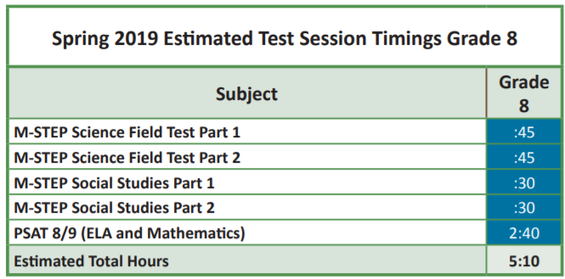
Estimated Times
Notes:
Here are the times for testing in 8th grade. The M-STEP science field test and the social studies assessment are required testing in 8th grade and come with the same timing caveats discussed on the prior slide. The PSAT 8/9 is a timed test and the time shown here is the actual time needed to administered the PSAT 8/9.
In 8th grade, unless MI-Access as been designated the most appropriate test for the student, all 8th graders are required to take the:
PSAT 8/9 for ELA and math scores
M-STEP Social Studies assessment
M-STEP Science Field Test

Slide 4
M-STEP Updates
Seating charts no longer required
Test Schedule documentation is now required
  Examples in Assessment Integrity Guide
Science Field Test
  Still required for participation purposes
  6 clusters where each cluster includes 5-8 items
    2 Earth Science
    2 Life Science
    2 Physical Science
  2 parts / 2 test tickets
    Each part estimated to take 30-45 minutes
Notes:
Here are the times for testing in 8th grade. The M-STEP science field test and the social studies assessment are required testing in 8th grade and come with the same timing caveats discussed on the prior slide. The PSAT 8/9 is a timed test and the time shown here is the actual time needed to administered the PSAT 8/9.
In 8th grade, unless MI-Access as been designated the most appropriate test for the student, all 8th graders are required to take the:
PSAT 8/9 for ELA and math scores
M-STEP Social Studies assessment
M-STEP Science Field Test

Slide 5
Standard Setting
for PSAT 8/9 in Grade 8
MDE and the College Board will conduct Standard Setting this year
  Required for Peer Review
  Goal is to maintain the College Board grade-level benchmark cut as the proficiency cut
    Evidence –based Reading and Writing section score
    Math section score
    Not overall PSAT 8/9 score
  Michigan educators will be critical to the process
  3 cuts and 4 performance levels
Notes:
Here are the times for testing in 8th grade. The M-STEP science field test and the social studies assessment are required testing in 8th grade and come with the same timing caveats discussed on the prior slide. The PSAT 8/9 is a timed test and the time shown here is the actual time needed to administered the PSAT 8/9.
In 8th grade, unless MI-Access as been designated the most appropriate test for the student, all 8th graders are required to take the:
PSAT 8/9 for ELA and math scores
M-STEP Social Studies assessment
M-STEP Science Field Test

Slide 6
Critical Date
Reminders
The following windows closed yesterday
  Pre-id for vendor provided barcode labels
    Barcode code labels for students who were not pre-id by yesterday’s deadline must be printed locally
  Initial Material Orders window
    Material quantities ordered were based on pre-id counts
    If additional materials are needed for new students, order during additional material order window
      PSAT 8/9 March 20 – March 28, 2019
      M-STEP April 2 – April 23, 2019 (window closes at noon)
Request PSAT 8/9 accommodations on SSD Online by February 19, 2019
Notes:
Here are the times for testing in 8th grade. The M-STEP science field test and the social studies assessment are required testing in 8th grade and come with the same timing caveats discussed on the prior slide. The PSAT 8/9 is a timed test and the time shown here is the actual time needed to administered the PSAT 8/9.
In 8th grade, unless MI-Access as been designated the most appropriate test for the student, all 8th graders are required to take the:
PSAT 8/9 for ELA and math scores
M-STEP Social Studies assessment
M-STEP Science Field Test

