Slide 1
Welcome and Introductions
Ellen Vorenkamp Ed.D.
Wayne RESA
vorenke@resa.net
Kristy Walters Ed.D.
Corunna Public Schools
kwalters@corunna.k12.mi.us
Notes:
KIM
Kim Young remains the project manager of FAME at the Michigan Department of Education.

Slide 2
Outcomes

Slide 3
Participant Learning Targets
Recognize formative assessment as a process
Acknowledge the benefits of a balanced assessment system
Recognize the roles and responsibilities of students, teachers, and administrators in an assessment literate classroom
Identify the role of the formative assessment process and the assessment literacy standards in a student-centered classroom
Reflect on your current practices and identify potential next-steps

Slide 4
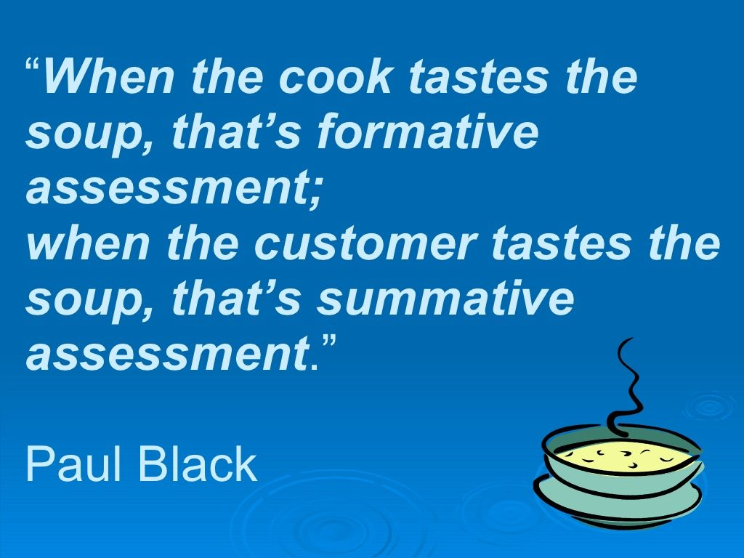
Balanced Assessment Systems
Summative Assessment
(Assessment of Learning)
Formative Assessment
(Assessment for Learning)
Notes:
COMMON DEFINTIONS FOR SUMMATIVE, INTERIM/BENCHMARK, AND FORMATIVE CLASSROOM ASSESSMENT!!

Slide 5
 | Summative |  | Formative
 | Annual | Periodic | Classroom
Key Question | Did the students learn what they should have? | Is the class/student on track for proficiency? | What comes next in the student’s learning?
When Asked | End of unit/ term/year | Multiple times per year | Ongoing in the classroom
Use of Results | After instruction ends (curriculum & instructional leaders) | Between instructional cycles (instructional leaders & teachers) | During Instruction (teachers & students)

Slide 6
What Do Assessments Tell Us?
Information on individual
student learning
National
State
District
Classroom
Assessments
Assessments
Assessments
Assessments
Adapted from R. J. Marzano & J.S. Kendall. (1996). A comprehensive guide to designing a standards-based district, school, or classroom. Alexandria, VA: Association for Supervision and Curriculum Development.
Notes:
Slide Purpose: To illustrate how different data provides varying levels of information about specific students. Recognize Michigan’s balanced, comprehensive approach to assessment and the dedicated efforts and budgetary support for training in classroom assessment practices/formative assessment. While we now that all types of assessment are important it is classroom assessment that provide us with the most information about student learning but how much time to we spend analyzing data from the state level assessments vs the classroom?

Slide 7
A Quick Review of the Research
  Little to no research shows any correlation between giving students high-stakes summative assessments and student achievement or growth.
  “Five reviews of the research in this area...synthesized a total of more than 4,000 research studies undertaken during the last 40 years. The conclusion was clear: When implemented well, formative assessment can effectively double the speed of student learning.”
  Changing Classroom Practice (Wiliam, 2007)
Research studies: (Black & Wiliam, 1998; Crooks, 1988; Kluger & DeNisi, 1996; Natriello, 1987; Nyquist, 2003)
Notes:
Testing without learning won’t help students. Giving a retake the next day without further learning, Timed tests for students who don’t know the material are not going to increase student learning.

Slide 8
Balanced Assessment Systems
Turn & Talk:
How would you describe your building, or our district, in terms of a balanced assessment system?
In what ways might it be in balance?
In what ways might it need improvement?
Notes:
Move into discussion of FA with Maya Angelou quote…
Do the best that you can until you know better and then when you know better, do better.
FA is about doing better in a way that we have control in our classrooms.

Slide 9
Newly Revised Definition
Partner discussion: Based on this definition, discuss what you think might be critical components of the Formative Assessment Process.
Formative assessment is a planned, ongoing process used by all students and teachers during learning and teaching to elicit and use evidence of student learning to improve student understanding of intended disciplinary learning outcomes and support students to become more self-directed learners.
- CCSSO FAST SCASS – Austin, TX: June 2017

Slide 10
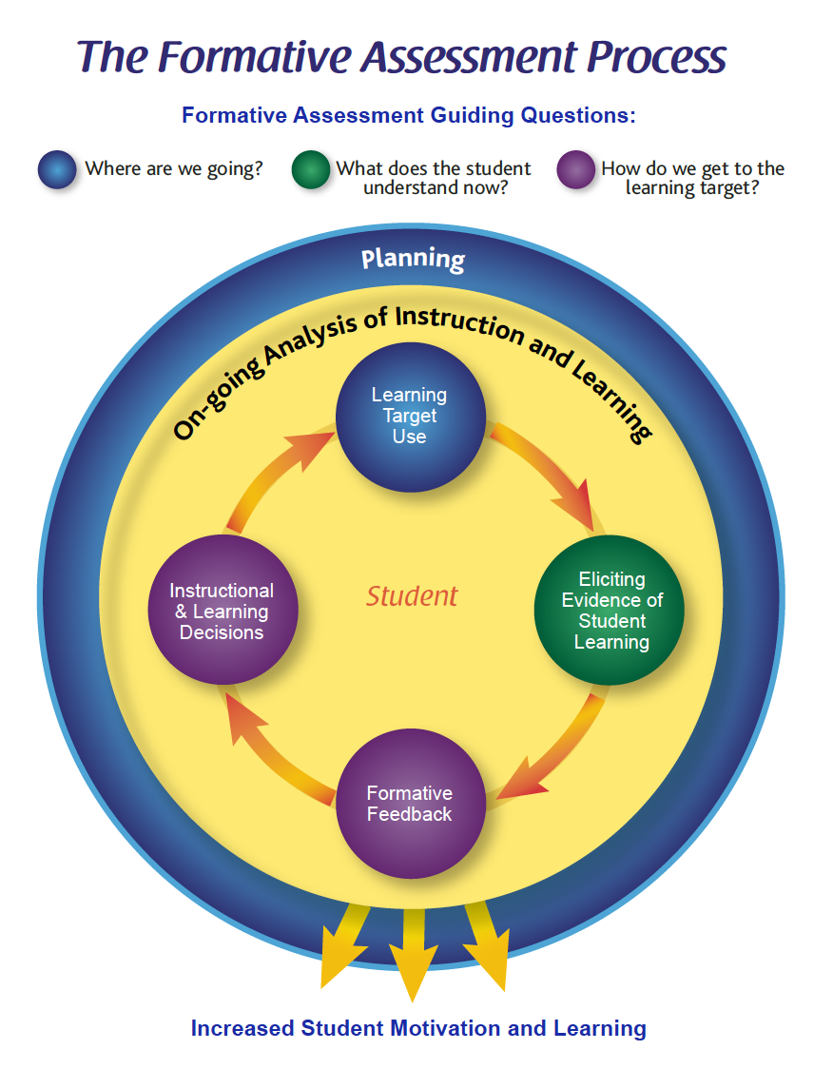
Notes:
First 25 minutes here

Slide 11
So what do students, teachers, and administrators need to know and do to create student-centered classrooms?

Slide 12

Assessment Literacy
Everyone with a stake in education needs to be assessment literate, including:
  Students
  Parents/guardians
  Teachers
  Specialists at the district and building levels
  Building administrators
  Central office administrators
  Policymakers at the local, state, and national levels
  Public
Notes:
Ellen

Slide 13
Why Assessment Literacy?
Assessment literacy is needed for several reasons
  Lack of understanding about assessment by those who adopt policy and laws, and govern our schools
  Lack of understanding by those who teach our students or lead our schools, due to continued lack of pre-service preparation for educators
  Misunderstanding by parents and students about how student assessment can promote high quality student learning
  Increased volume and changes in types of student assessments
  Increased stakes for students, educators, and schools
Notes:
Ellen

Slide 14
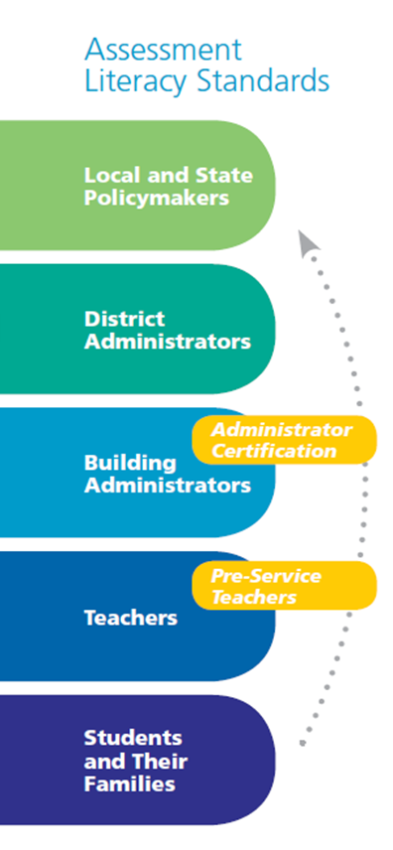
Assessment Literacy Standards Development
Separate standards were developed for:
  Local and state policymakers
  District administrators
  District administrators
  Teachers
  Students and Parents
Notes:
Lisa

Slide 15
Assessment Literacy Standards Development
The MAC Assessment Literacy standards include
  Dispositions (i.e., beliefs)
  Knowledge
  Performance (i.e., skills)
Goal—provide a common basis for work in increasing assessment literacy
Notes:
Lisa

Slide 16
Let’s take a look…

Slide 17
Assessment Literacy and Formative Assessment…The Intersections
If students, teachers, and administrators engage in the Formative Assessment Process with fidelity…oh the places we’ll go!
FA Components | Students | Teachers | Building Administrators
Planning
Learning Target Use
Eliciting Evidence of Student Understanding
Formative Feedback
Instructional & Learning Decisions

Slide 18
Video:
conjectures or kindergarten teacher counting collections
Include similar table from previous slide with focused verbs to help the participants know what to focus on while they are watching the video

Slide 19
Dialogue around what participants are seeing in the video
What are you seeing around what the teachers/students/administrators know about assessment literacy and formative assessment

Slide 20
How might your thinking be different now and what might be your next steps toward improving your own practice (FA and assessment literacy knowledge of balanced assessment)

Slide 21
Interested in 2019-20 FAME?
Name
Professional Role
District Name
Email
Notes:
Kim

Slide 22
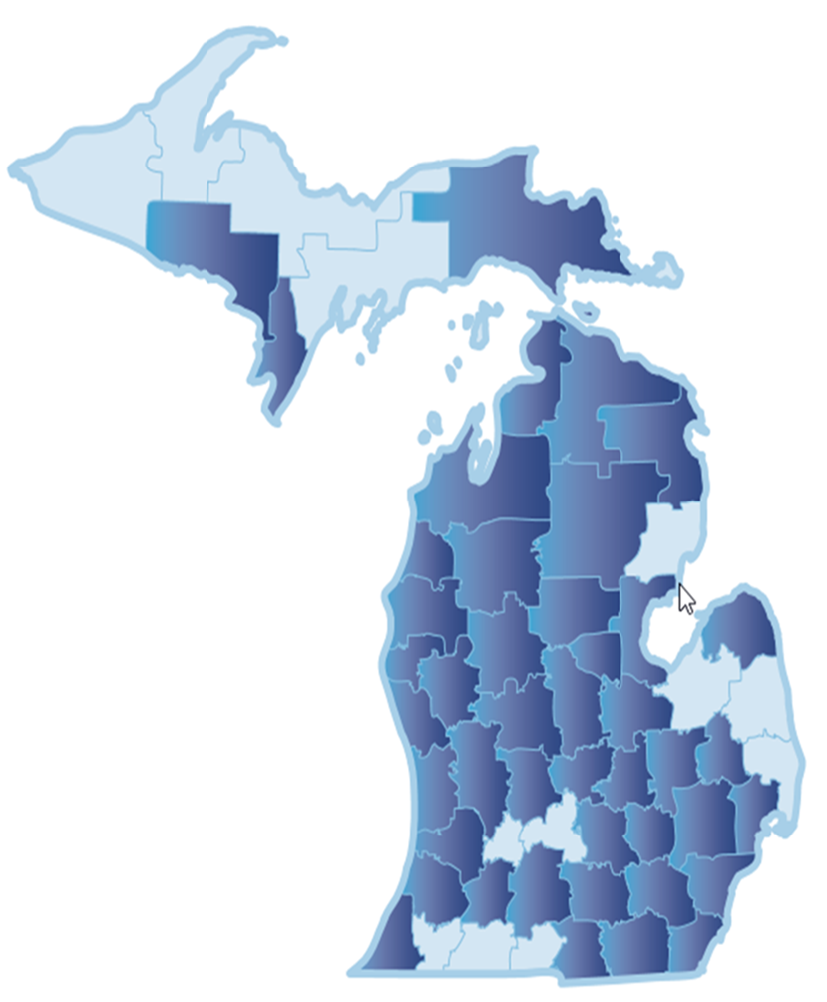
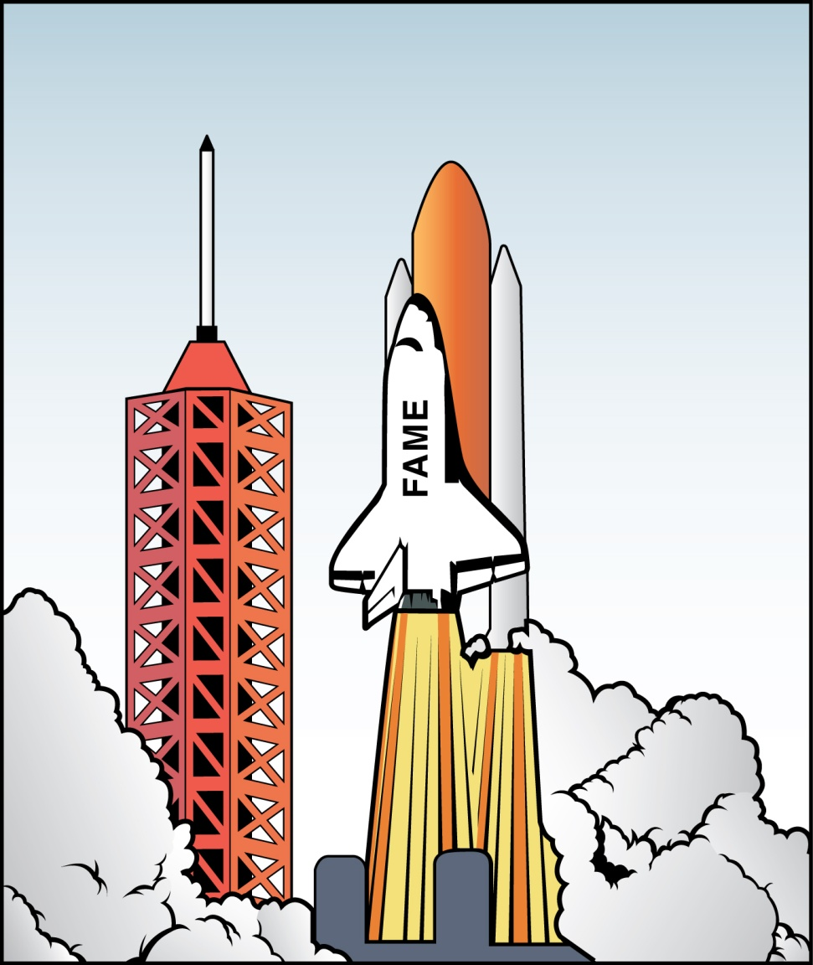


Thank You!

