Slide 1
Standards-Based Grading
MSTC
February 14, 2019
Lena Nemeth & Ellen Vorenkamp

Slide 2
Welcome & Introductions

Slide 3
Community Builder
On the Kleen Slate write down your GPA from either high school or undergraduate college experience.
Line up according to your GPA…highest to lowest
Pair up
Dialogue around how your grade made you feel…good experience? bad experience?
Debrief conversations and activity

Slide 4
Agenda
Explore purpose of Grading
Explore Grading Models
Define Standards-Based Grading
Define the need for Standards-Based Grading
The Learning Journey that Leads to Standards-Based Grading

Slide 5
Purpose of Grading

Slide 6
What is the Purpose of Grading?
Brainstorm at your tables…
If you were to ask the question…what is the purpose of grades? to each of these groups of stakeholders…what would their responses sound like?
Students
Teachers
Parents

Slide 7
Video—Purpose of Grading

Slide 8
History of Grading

Slide 9
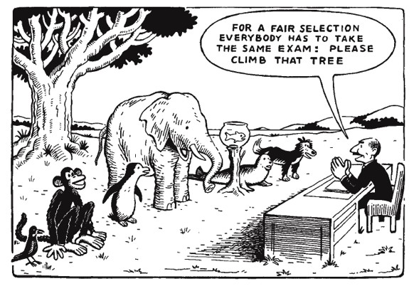
Grading Time Line
So how did grading become so convoluted?

Slide 10
History of Grading
Percentage Grading
Letter Grades/ Mastery Grading
Focus on Student Learning
c.1910
c.1950
c.1990
c.1890
Normal Curve Theory
c.1925
Grading on Standards
c.1970
Teacher Competence in Grading
Evaluations of Student Work
Currency “pay” for work students do
Vehicle for Promotion or Retention
Public Relations/ Accountability
Motivator
Destroyer
University/High Ed

Slide 11
Research on Grading

Slide 12
What does the research indicate?
Looking at Research by Exploring Obstacles to Grading Reform

Slide 13
Reading Protocol
Read Text
√ = Makes sense; affirms my thinking
! = “aha”; new insight
? = Raises a question, challenges my thinking

Slide 14
Grading Models

Slide 15
Traditional Grading
Traditional grading is easy to spot because it typically involves:
Simple letter grades.
Assessments based on teacher-defined criteria.
A single overall grade per student based on a combination of related and unrelated assessments of skills, knowledge, performance and conduct over a period of time.
The main advantages of this method are simplicity and professional freedom. However, it results in a very limited measure of a student's abilities. The A on a child's report card might thrill the parents, but this grade obviously doesn't convey any precise information.
Blackboard help.com

Slide 16
Traditional Grading
1. Based on assessment methods (quizzes, tests, homework, projects, etc.). One grade/entry is given per assessment.
2. Assessments are based on a percentage system. Criteria for success may be unclear.
3. Use an uncertain mix of assessment, achievement, effort, and behavior to determine the final grade. May use late penalties and extra credit.
4. Everything goes in the grade book – regardless of purpose
5. Include every score, regardless of when it was collected. Assessments record the average – not the best – work.
Mark Townsley @ comptencyworks.org

Slide 17
Traditional Grading
In a traditional grade book, one usually sees student names listed down the left side of the page and a variety of headings across the top of each page. The titles across the top of the page might include descriptors such as chapter test, homework, pop quiz, class participation, extra credit, unit test, and in some cases, student behavior. The scores or grades for each of these designations may or may not be clearly and precisely linked to the standard which was addressed. In the best case scenario, the teacher using the traditional approach had made sure to connect the assessment instrument to the standards the students were expected to learn, while in the worst case scenario, there may be only a loose or fuzzy link to the standards, connections that are almost accidental rather than deliberate, or no connection at all.
Bruce Oliver @ Just Ask Publications

Slide 18
Standards-Based Grading An Overview

Slide 19
What is SBG?
Standards-Based Grading is a method of reporting what students have learned and how they demonstrated their learning of the content standards required by the state in which they reside.
The U.S. Department of Education includes the following guidelines for standards-based grading:
Grades must be related to academic standards and course expectations
Public success criteria and student work samples (exemplars) are reference points for grading
Grades should be based only on individual academic achievement
Grades are based on quality assessments and properly recorded achievement evidence
Bruce Oliver @ Just Ask Publications

Slide 20
What is SBG?

Slide 21
What is the purpose of standards-based grading?
Most states and school districts have published content standards that teachers are expected to teach in their courses or at their grade levels.
The purpose of standards-based grading is to align grading practices with the content standards by more accurately measuring and reporting students’ proficiency in meeting those standards.
Bruce Oliver @ Just Ask Publications

Slide 22
Why Standards-Based Grading

Slide 23
Why SBG?
Grades should be meaningful and consistent to students, teachers, and families
Grades should be objective and not subject to teacher opinions
Grades should provide specific feedback to students about their performance and learning opportunities
Grades should support learning targets

Slide 24
Turn and Talk
How confident are you that the grades students receive in your school/district are:
consistent,
accurate,
meaningful, and
supportive of learning?

Slide 25
Why is standards-based grading important and why now?
Vital components of the standards-based reform movement are clear measurable course or grade level outcomes and accurate measures to determine where each student stands in relation to the standards.
With the adoption and adherence to standards-based learning, it can be easily and readily assumed that all teachers link their planning and lesson implementation to the identified standards. And yet, in some schools, there still remains a disconnect between the teaching of required standards and how student mastery of these standards is determined.

Slide 26
Why is standards-based grading important and why now?
Many teachers still follow more established grading practices, and, in fact, there is little clear articulation between the grades students receive and the content standards which are taught. Some have even surmised that our current grading practices lack real meaning as reported achievement data is inconsistent and imprecise. As Robert Marzano has concluded, “grades have become almost meaningless.”

Slide 27
The Journey to SBG
Community Investment
Awareness & Ongoing Communication
Learning Standards
Guaranteed Viable Curriculum
Quality Evidence
Matching Learning Progressions to Levels of Mastery
Communicating Achievement
Reporting Student Progress
Research/Rationale
Assessment Literacy
Professional Learning
Essential Skills/Priority Standards
Language of the Learning Targets
Alignment of Content and Assessment
Quality Assessment Practices
Learning Progressions
Using Evidence to Measure Learning
Using the MISTAR Q Report Card
Quality Grading Practices
Grading Models

Slide 28
Community Investment
Awareness & Ongoing Communication
Research/Rationale
Assessment Literacy
Professional Learning

Slide 29
Learning Standards
Guaranteed Viable Curriculum
Essential Skills/Priority Standards
Learning Progressions
Language of the Learning Targets

Slide 30
Quality Evidence
Matching Learning Progressions to Levels of Mastery
Alignment of Content and Assessment
Quality Assessment Practices
Using Evidence to Measure Learning

Slide 31
Communicating Achievement
Grading Models
Reporting Student Progress
Quality Grading Practices
Using the MISTAR Q Report Card

Slide 32
Reflection

Slide 33
Contact Information

