Slide 1
Update on new Social Studies Standards and How State Assessments are Created
Michigan School testing Conference 2019
Notes:
Linda – Introduction of the presentation and team

Slide 2
Office of Educational Assessment and Accountability
(OEAA)
Presenters
John Jaquith (Test Development Manager)
Susan Palmiter (Assessment Consultant: Social Studies)

Slide 3
Take-Aways
Update on Michigan’s revised K-12 Social Studies Standards
Improved understanding of how M-STEP assessments are developed
Gain assessment ideas and structures to take back to your districts to help you develop your local assessments

Slide 4
K-12 Social Studies Standards Update
2007 MDE adopted K-12 Social Studies standards based on National Council for the Social Studies C3 Framework (College, Career, and Civic Life)
2014 SBE requested an update to these Social Studies standards
Task Force consisting of (5) content area committees and bias review committee begin drafting updated standards
Held Listen and Learn sessions to gain input from stake-holders across State
2018 Concerns and challenges raised to some of the proposed standards

Slide 5
K-12 Social Studies Standards Update
MDE extended public comment period and the review process
Listen and Learn public input sessions held thru September 30, 2018
February 8: Content & Bias Committee Co-Chairs met to continue their work on a final proposed draft
February 25-28: Additional representatives of diverse community groups will be meeting to review and potentially provide additional input
March 2019: Content & Bias Co-Chairs will meet to work on Final Draft
Also preparing a “Cut and Cap” version with side-by-side of 2007 and current proposed Standards and a version stating rational for any revisions

Slide 6
Stay tuned…
Revised K-12 Social Studies Standards hopefully ready to submit to the State Board of Education April 2019
Possible vote on the Revised Standards as early as mid-June 2019
When the new K-12 Social Studies Standards are adopted by the State Board of Education…
Professional Development opportunities will be offered to educators
Dept. of Education will focus on test development work that insures our state assessments align with the new Social Studies Standards

Slide 7
M-STEP Social Studies 2019
No changes – will be similar to 2018
Grades 5, 8 and 11

Slide 8
The Life Cycle of a M-STEP Item

Slide 9
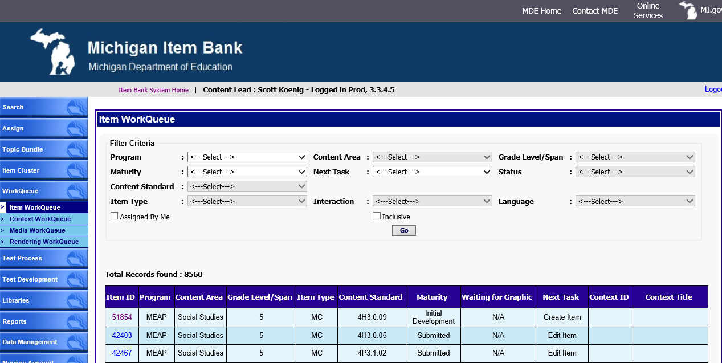
This is the Michigan Item Bank System (IBS)

Slide 10


Context
Review
(Content & Bias)
Context
Writing
Context
Editing
Item Writing
FT Forms
Construction
Item Review
(Content & Bias)
Item Editing
/ Graphics
Field Testing
Pool of Operational Items
Rangefinding
For CR Items
Scoring
Data Review

Slide 11
Item Writing Basics

Slide 12
Items Should
assess a content standard and/or benchmark.
Include accurate content information
be grade level appropriate including: appropriate cognitive level, reading levels, and thinking skills
be equitable based on gender, ethnicity, race, social class, disability, geography, etc.
be fair, clear, concise, and free of cueing
avoid emotionally charged topics (natural disasters, illness, divorce, loss of jobs) unless standard and/or benchmark specifies it
adhere to the MDE approved style guidelines
contain graphics that are clear, relevant, accurate and necessary
be reviewed and approved by content review committees and bias/sensitivity committees before field testing
require a professional editor to review items for verification before field testing

Slide 13
Multiple Choice (MC) and Technology Enhanced (TE) Items Should
propose a single problem though solution may require more than one step
avoid repeated words from the stem in the answer choices
restrict negatives “not” or “none”
have distractors that are in logical order, avoid clues, and are comparable in length, complexity, and grammatical form
make certain a distractor is not a possible answer

Slide 14
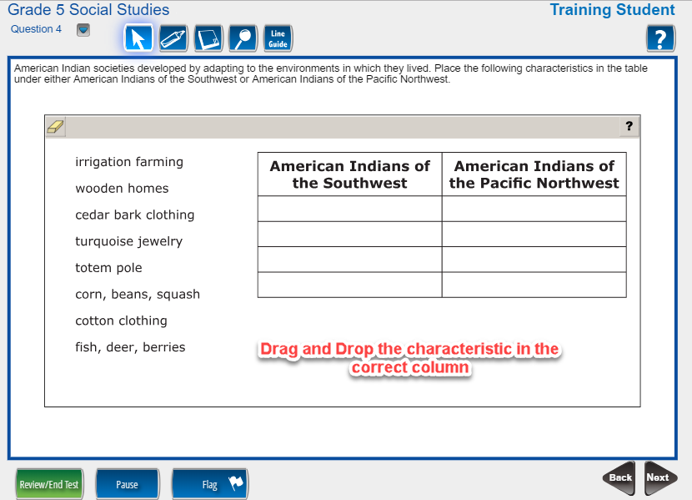
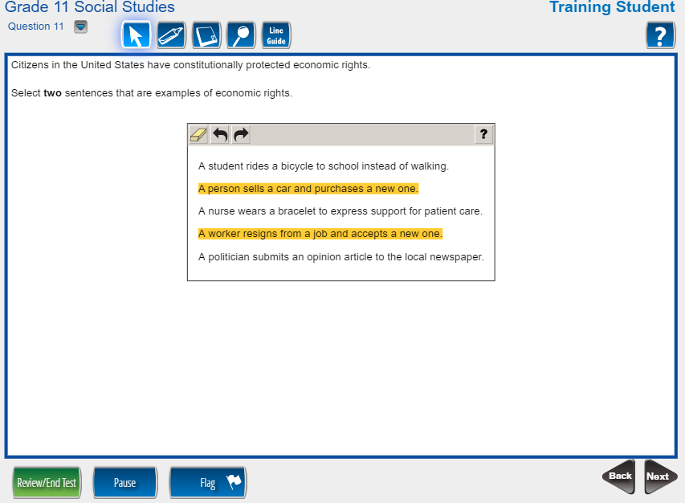
Multiple Choice (MC) and Technology Enhanced (TE) Items

Slide 15
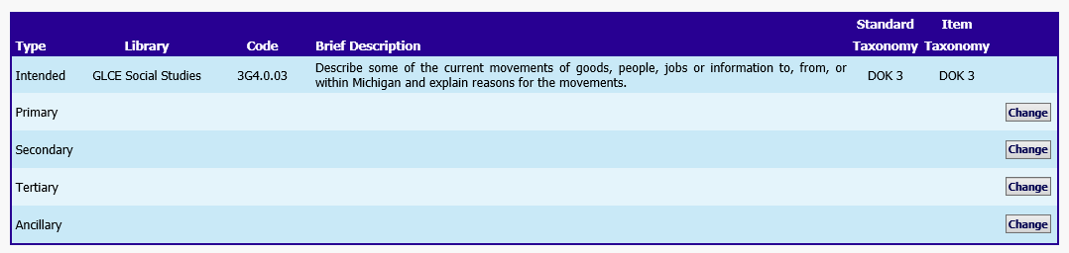
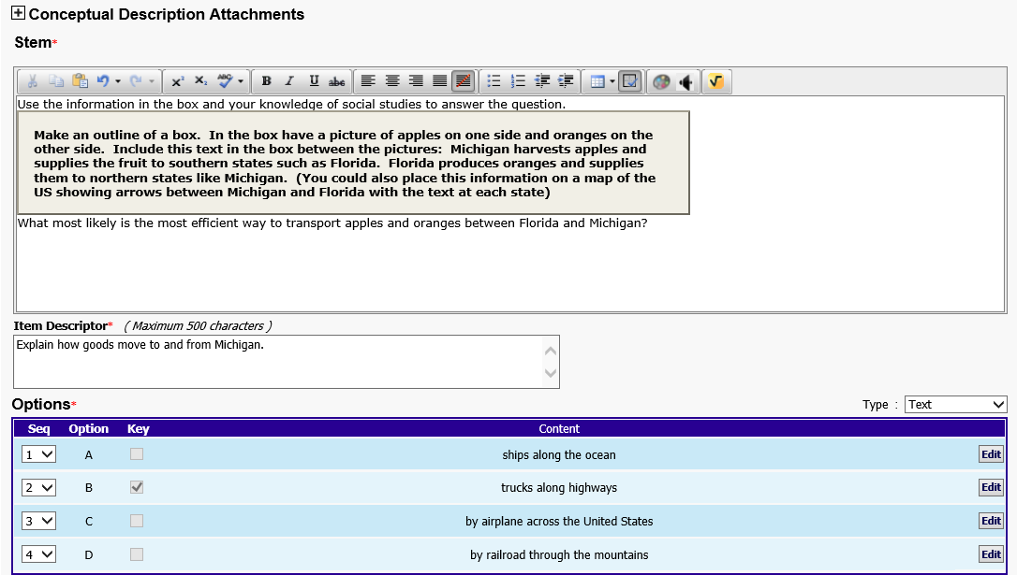

Item Writer
Standard Assignment
Item Idea and Options
Content Lead Feedback

Slide 16
Context
Review
(Content & Bias)
Context
Writing
Context
Editing
Item Writing
Item Review
(Content & Bias)
Item Editing
/ Graphics

Slide 17
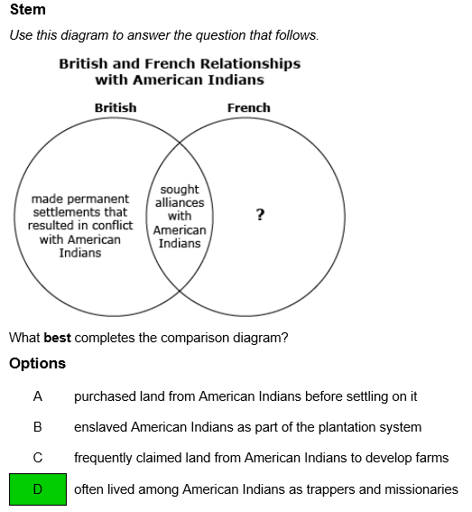
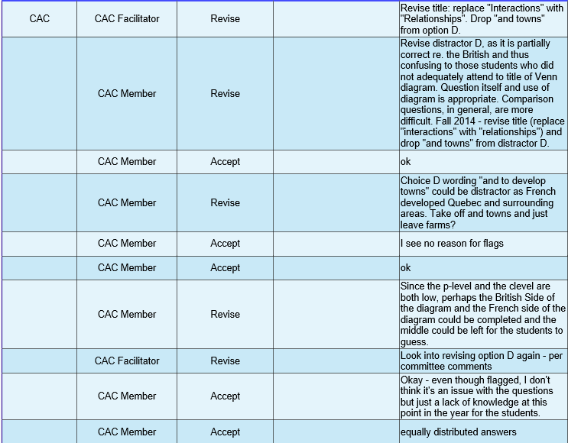
Item View – Content Review
CAC Comments

Slide 18
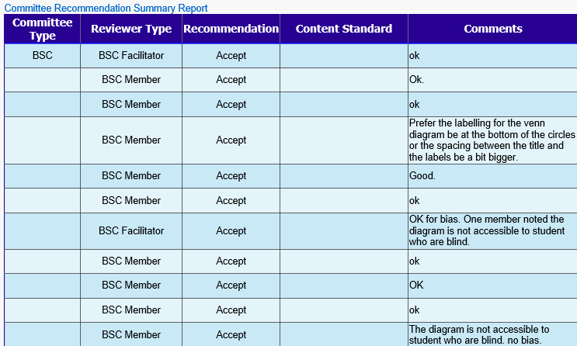
Item View – Bias Review
BSC Comments

Slide 19
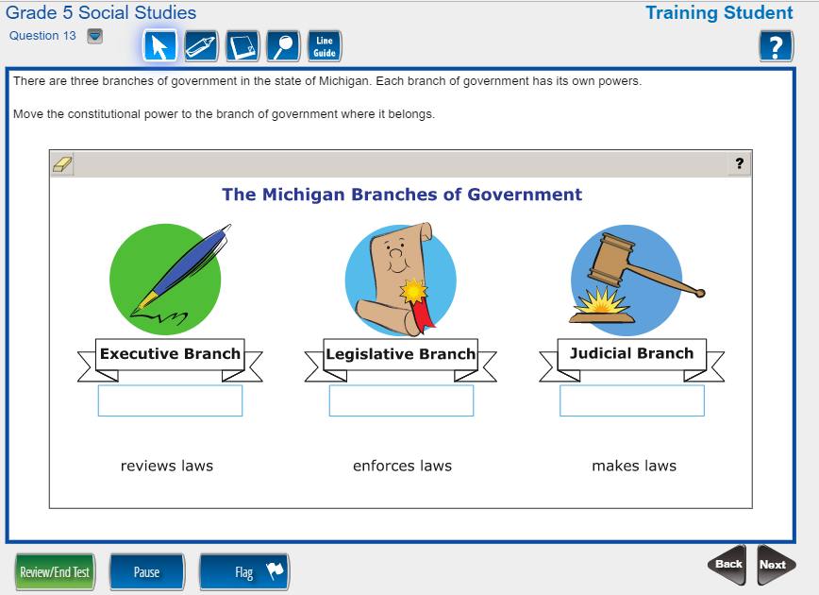
Item Bank System – Accepted Item

Slide 20
Context
Review
(Content & Bias)
Context
Writing
Context
Editing
Item Writing
FT Forms
Construction
Item Review
(Content & Bias)
Item Editing
/ Graphics
Field Testing

Slide 21
Context
Review
(Content & Bias)
Context
Writing
Context
Editing
Item Writing
FT Forms
Construction
Item Review
(Content & Bias)
Item Editing
/ Graphics
Field Testing
Pool of Operational Items
Rangefinding
For CR Items
Scoring
Data Review

Slide 22
IteM DaTA Review
Item
with
Statistics
Committee Comments
On Statistics
DATA Committee Comments

Slide 23
Committee Reviews

Slide 24
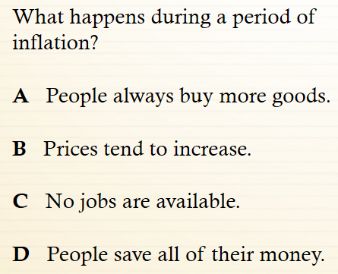
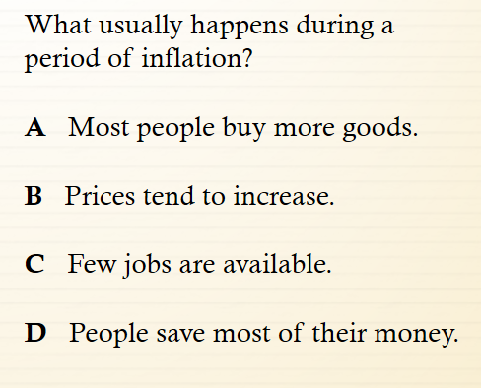
The Committee Review Game:
Poor Example vs. Revised Example
Example A
Example B

Slide 25
The Committee Review Game:
Poor Example vs. Revised Example
Poor Example
Revised Example

Slide 26
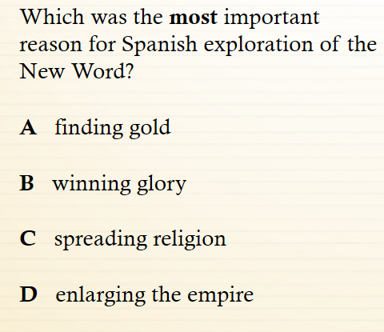
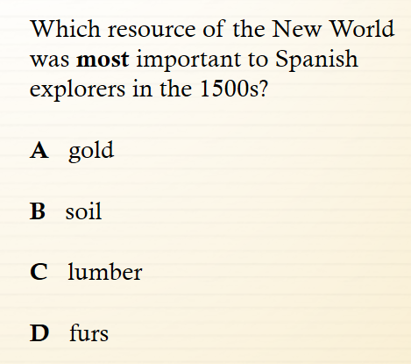
The Committee Review Game:
Poor Example vs. Revised Example
Revised Example
Poor Example
Example A
Example B

Slide 27
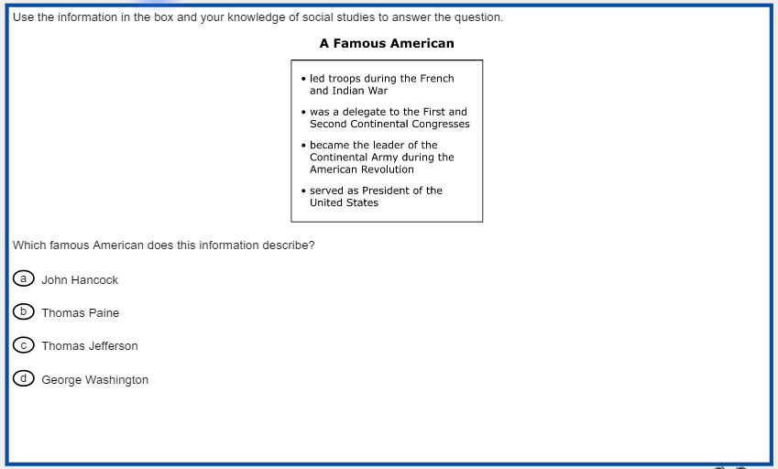
The Committee Review Game:
Match the Standard
4G2.0.01 Describe ways in which the United States can be divided into different regions (e.g., political regions, economic regions, landform regions, vegetation regions).
5U3.1.02 Describe the causes and effects of events such as the Stamp Act, Boston Tea Party, the Intolerable Acts, and the Boston Massacre.
5U3.1.06 Identify the role that key individuals played in leading the colonists to revolution, including George Washington, Thomas Jefferson, Benjamin Franklin, Patrick Henry, Samuel Adams, John Adams, and Thomas Paine.

Slide 28
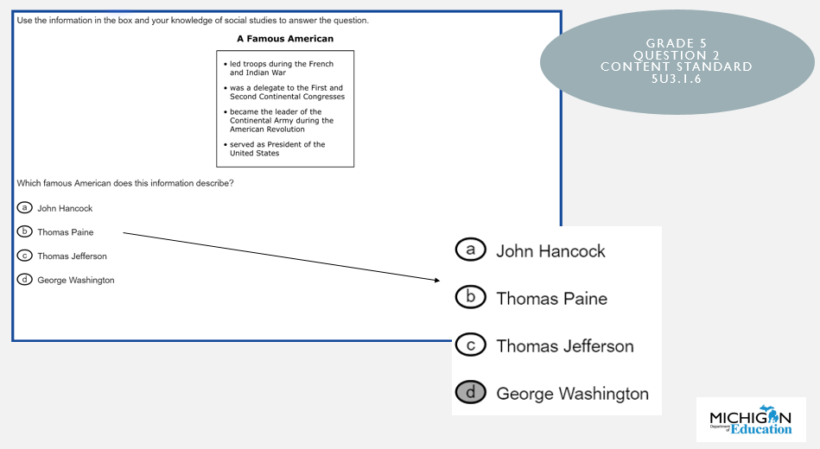

The Committee Review Game:
Match the Standard
Answer: 5U3.1.06 Identify the role that key individuals played in leading the colonists to revolution, including George Washington, Thomas Jefferson, Benjamin Franklin, Patrick Henry, Samuel Adams, John Adams, and Thomas Paine.

Slide 29
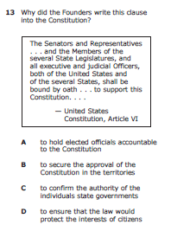
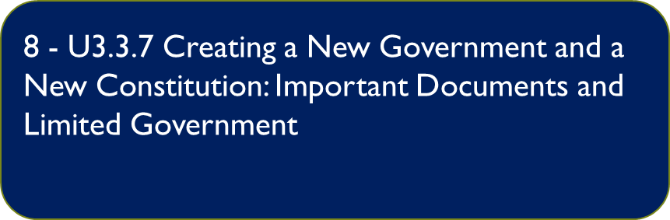
The Committee Review Game:
Match the Standard
6 – C3.6.1 characteristics of a nation-state and how Western Hemisphere nations interact.
7 - C1.1.1 Purposes of Government: Government Service

Slide 30
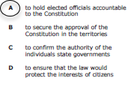
The Committee Review Game:
Match the Standard
Answer: 8 - U3.3.7 Creating a New Government and a New Constitution: Important Documents and Limited Government

Slide 31
Blueprints, Test maps, and Rendering

Slide 32
Test development
Guided by a set of test specifications
Universal design describes the use of test formats that allow tests to be taken without adaptation by as broad a range of individuals as possible
Summative forms in Michigan
  Online fixed form (K-2 Benchmarks in ELA and Math, MI-Access)
  Online Computer Adaptive (M-STEP)
  Paper/pencil (M-STEP, MI-Access)
  Accommodated forms (M-STEP, MI-Access)

Slide 33
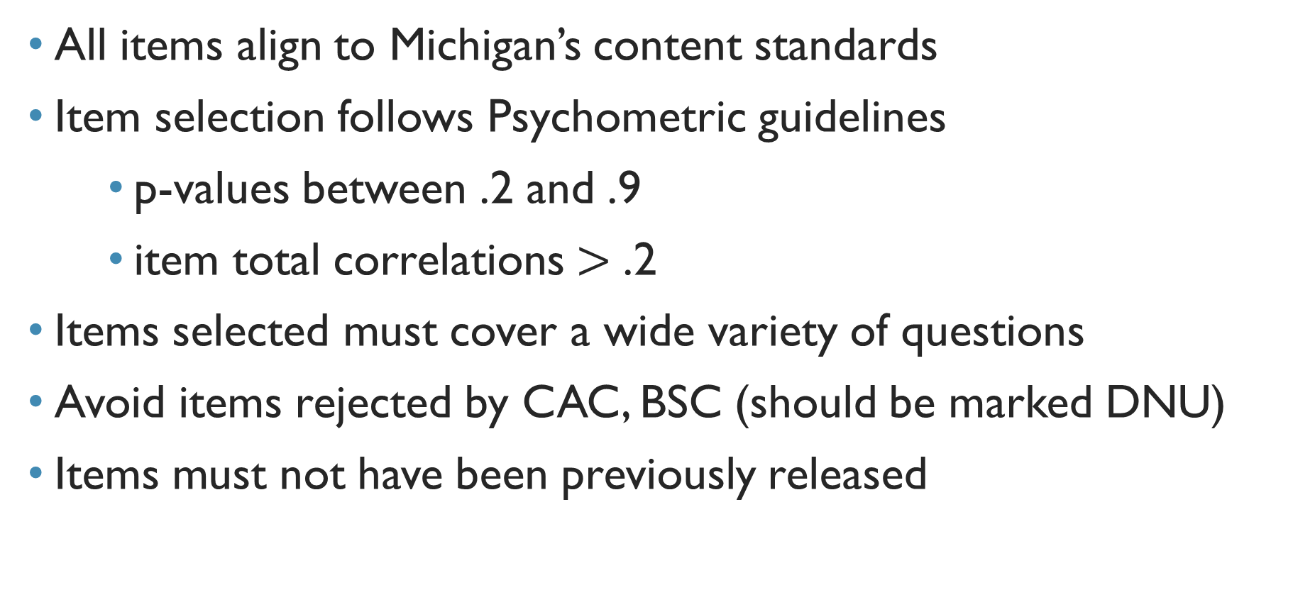
Test development
All items align to Michigan’s content standards
Item selection follows Psychometric guidelines
      p-values between .2 and .9
      item total correlations$>$ .2
Items selected must cover a wide variety of questions
Avoid items rejected by CAC, BSC (should be marked DNU)
Items must not have been previously released

Slide 34
Test blueprints
Original test blueprint approved by MDE’s Test Development and Psychometric unit
Use original, approved blueprint for valid score reporting and interpretation
Content Lead creates modified blueprint each testing cycle
  Ensure variety of standards assessed per domain while maintaining points per domain consistency year-to-year
  Pre-selected anchor (equating) items from prior year
Blueprint dictates # of operational items and # of field test items
  Length of test vs testing time – big consideration
Content Lead selects item type (CR, MC, TE) and mode (Online/P-P)

Slide 35
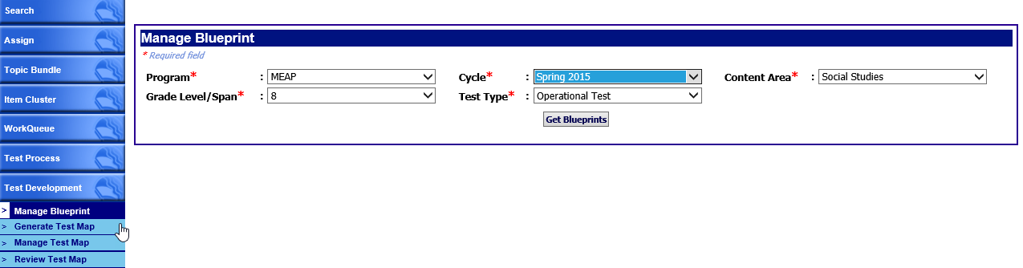
Blueprints and Forms – The beginning

Slide 36
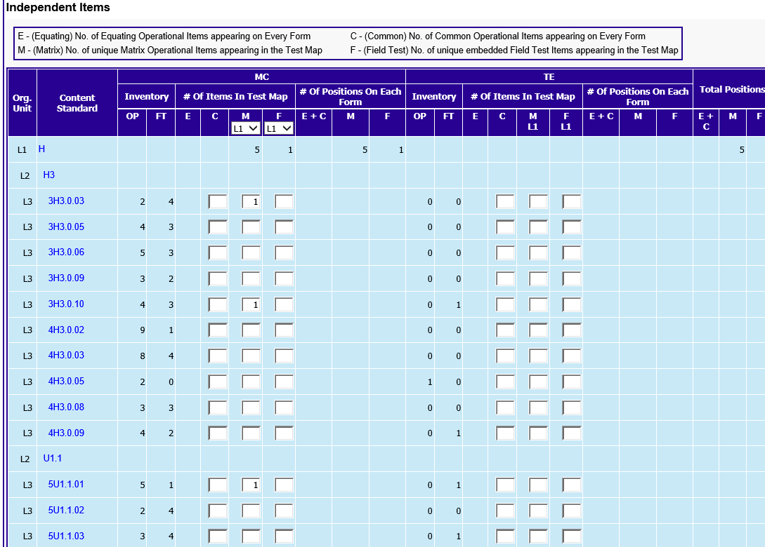
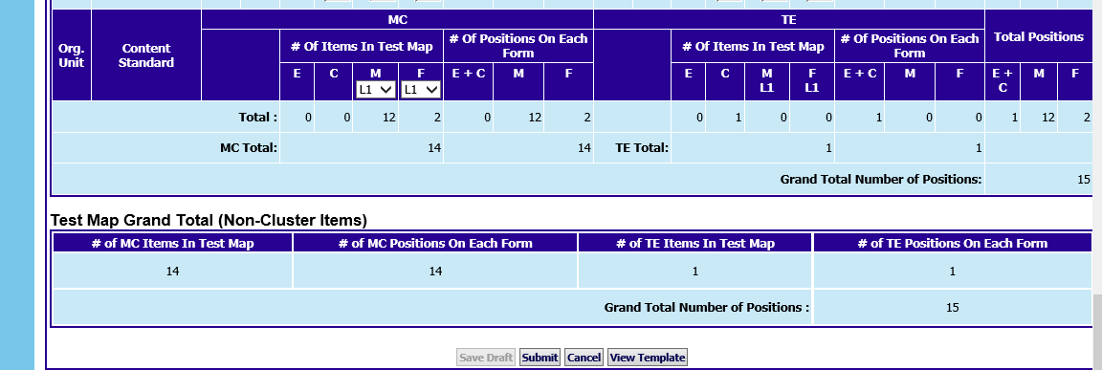
Blueprint Details

Slide 37
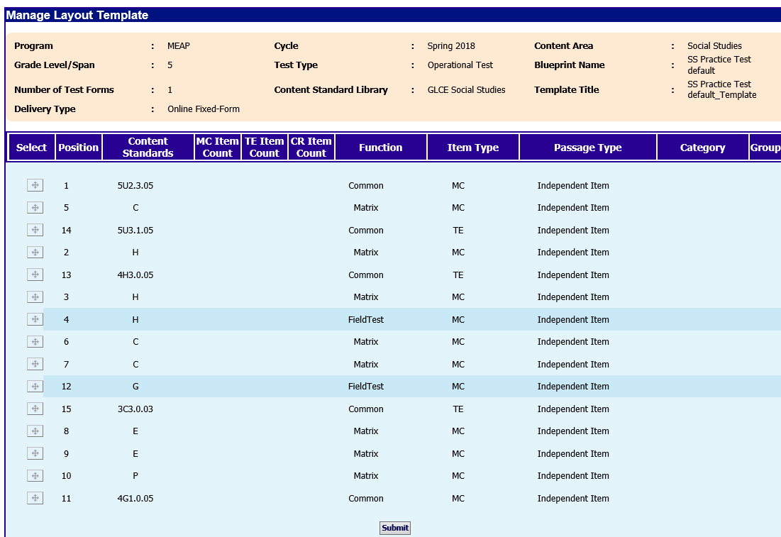
Blueprint Layout

Slide 38
IBS Magic
Once blueprint is completed, Content Lead selects ‘IBS generate’ to build the test forms containing specific items
IBS designed to select items following pre-determined formula
Content Leads review each item on each form to:
  Each form addresses a range of standards
  Prevent cueing
  Replace an item that is too similar to another on the form
  Check that answer keys are comparable on each form
Content Lead has discretion to replace any and all items
Upon Content Lead approval, test map submitted for Psychometric review and approval

Slide 39
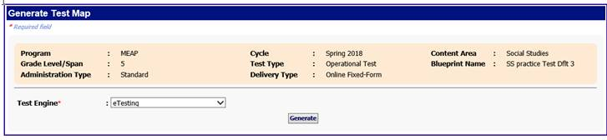
IBS GENERATES TEST MAP

Slide 40
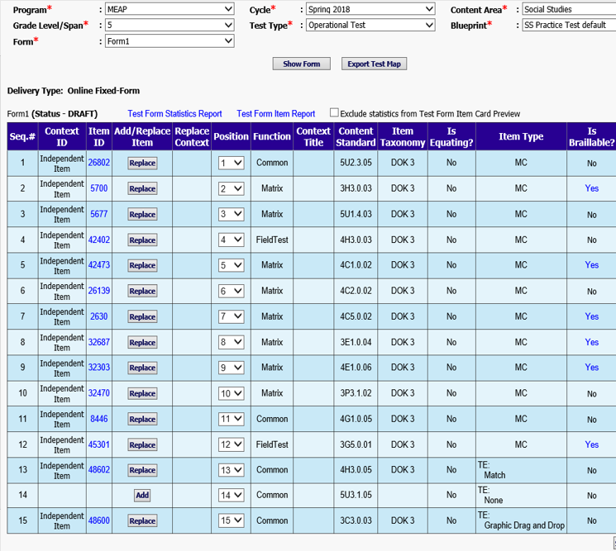
A Test Form

Slide 41
Test item/form review
After Psychometricians approve test map, it is exported to DRC
DRC renders each item according to MDE-approved style guide, in the online test delivery system and delivers to OEAA
OEAA Rendering Lead and Content Lead review each item in the way they will appear to students, comparing each rendered item to the item in IBS
If changes are needed, the item goes back to DRC for re-rendering
Once all items in a program, grade, and content are approved, DRC creates forms in the delivery engine
Content Lead reviews forms for accuracy, using the IBS test map
Examples of rendered items are in Sample Item Sets

Slide 42
The Importance of Michigan Educators

Slide 43
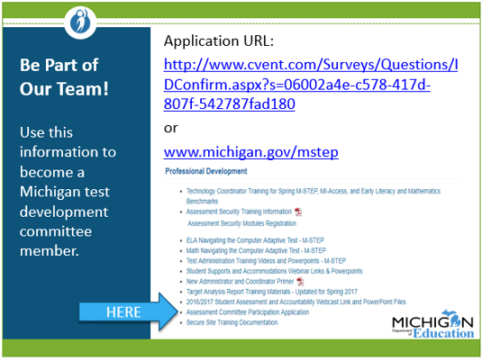
Assessments are developed
by Michigan educators for Michigan classrooms
WHY we need local experts
Local Leaders are our Experts
Locals assist “buy in” to the importance of assessment
Sound practice for assessment development
Fair equitable assessments

Slide 44
Contact Information
Office of Educational Assessment and Accountability
Phone: 1-877-560-8378
Website: www.michigan.gov/oeaa
Email: Mde-oeaa@Michigan.gov

